Slide 1
Structured Files
CS 142
David Anderson
Slides by Martin Hock

Slide 2
File formats
Files on computers can be used to represent photographic images, line-based images, sounds, video, documents, presentations, and so forth
Each of these concepts has inherent structure behind it: an image is a two dimensional array of pixels (which may have techniques to eliminate redundant information called compression)
Let’s come up with an idea for information we can store and then define a file format for it which we can read and write

Slide 3
Parsing
When we read formatted data into memory, we call the technique parsing
We are trying to reconstruct the structure of the data being described
We have to understand how Scanner reads data in order to understand how to parse a file with it

Slide 4
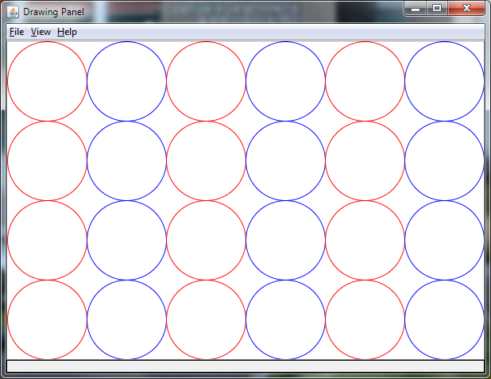
GFX142 file format
Let’s make a file format to represent things we can draw using a Graphics object!
We want to represent images like the one on the right
We’ll start by saying the size of the window, then describe each object that we want to draw
Since we use a drawOval command, we’ll call each object an oval

Slide 5
Review: Getting started with DrawingPanel
You can find DrawingPanel by going to the following URL: http://www.buildingjavaprograms.com/supplements4.shtml
Scroll down to DrawingPanel.java. There are two versions.
Download the appropriate version (probably the latest one) into the src folder for a project, then refresh the src folder.
You can download the file elsewhere, then drag and drop it into the src folder.
There may be some issues that you have! Please let me know.
In the future, we’ll try to find a simpler way to get started with drawing.

Slide 6
Tokens and delimiters
Scanner views its input in terms of tokens and delimiters
A token is a very rudimentary data format that a Scanner can interpret
We can describe an integer in terms of the token format, so Scanner is capable of recognizing them
Another example: doubles
Delimiter characters are between tokens and, by default, Scanner understands whitespace (carriage return, newlines, spaces, and tabs) to be delimiter characters

Slide 7
How Scanner reads an int
When we call readInt() on a Scanner object, we are telling it that it should assume that an integer is available to be read
Scanner will read delimiter characters until it sees characters that it expects to be an int
It will throw an exception if it sees something that is neither an int character nor a delimiter, for example, an alphabetic character
Once it sees another delimiter after int (digit) characters, it stops

Slide 8
How Scanner reads an arbitrary token
When we call next() on a Scanner object, similar to nextInt(), we’ll read whitespace, followed by anything but whitespace, and keep reading until we see whitespace (including a newline)
The non-whitespace characters make up the token
We’ll put a command word for this token that describes what we want to draw
After we read the command word, we can read the arguments for the command
We can perform the above in a loop to read in as many commands as the file describes

Slide 9
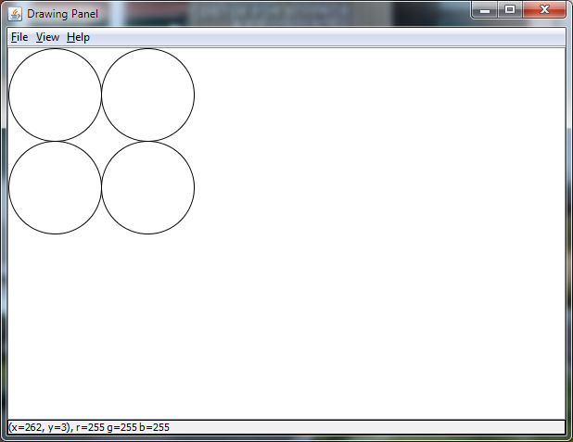
Example file
600 400
oval 0 0 100 100
oval 0 100 100 100
oval 100 0 100 100
oval 100 100 100 100

Slide 10
Reading a file with Scanner
Previously, we opened the file this way:
Scanner s = new Scanner(new File("C:\\Path\\File.txt");
Instead, we can use a file picker:
JFileChooser chooser = new JFileChooser();
chooser.showOpenDialog(null);
Scanner s = new Scanner(chooser.getSelectedFile());
Once we open the file, we have to read the size of the window because it’s the first thing in the file:
int width = s.nextInt();
int height = s.nextInt();

Slide 11
Setting up the window
Now that we read in the width and height, we can create the window and retrieve its graphics context:
DrawingPanel panel = new DrawingPanel(width, height);
Graphics g = panel.getGraphics();

Slide 12
Code to read and draw ovals in a loop
We’ll loop as long as there is another command word to read:
while (s.hasNext()) {
We’ll read the next command word:
String command = s.next();
Check to see if it’s the “oval” command:
if (command.equals("oval")) {
If so, draw an oval based on the subsequent four ints!
g.drawOval(s.nextInt(), s.nextInt(), s.nextInt(), s.nextInt());
}
}

Slide 13
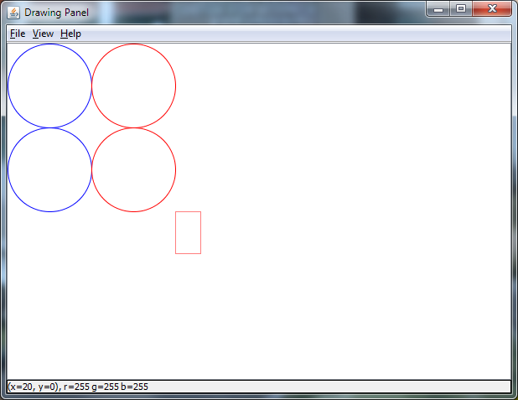
Enhance!
Let’s add a “rectangle” command to specify a rectangle and a “color” command to change colors
Example below:
600 400
color 0 0 255
oval 0 0 100 100
oval 0 100 100 100
color 255 0 0
oval 100 0 100 100
oval 100 100 100 100
color 255 127 127
rectangle 200 200 30 50

Slide 14
Code for additional commands
We can add a command after the “if” to handle a “rectangle” command:
else if (command.equals("rectangle")) {
g.drawRect(s.nextInt(), s.nextInt(), s.nextInt(), s.nextInt());
}
As well as a command to set the color using red, green, and blue values (in the range 0-255, per the Color Javadoc):
else if (command.equals("color")) {
g.setColor(new Color(s.nextInt(), s.nextInt(), s.nextInt()));
}

Slide 15
Review: Drawing programmatically
for (int x = 0; x + 100 <= width; x = x + 100) {
if (x / 200 * 200 == x) g.setColor(Color.RED);
else g.setColor(Color.BLUE);
for (int y = 0; y + 100 <= height; y = y + 100) {
g.drawOval(x, y, 100, 100);
}
}

Slide 16
Writing a file
We can modify the code we wrote that drew circles in columns and have it write to a file
Begin by creating a PrintStream attached to a file:
PrintStream f = new PrintStream("C:\\Users\\Default\\file.txt");
We can say file.println("String here!"); just like we have done with System.out since Day 1
Be sure to call file.close(); before the program exits or the file won’t be written!

Slide 17
Writing to the file
PrintStream f = new PrintStream("C:\\Users\\Default\\file.txt");
for (int x = 0; x + 100 <= width; x = x + 100) {
if (x/200 * 200 == x) f.println("color 255 0 0");
else f.println("color 0 0 255");
for (int y = 0; y + 100 <= height; y = y + 100) {
f.println ("oval "+x+" "+y +" 100 100");
}
}
f.close();

